Slide 1

October Kudos

Slide 2
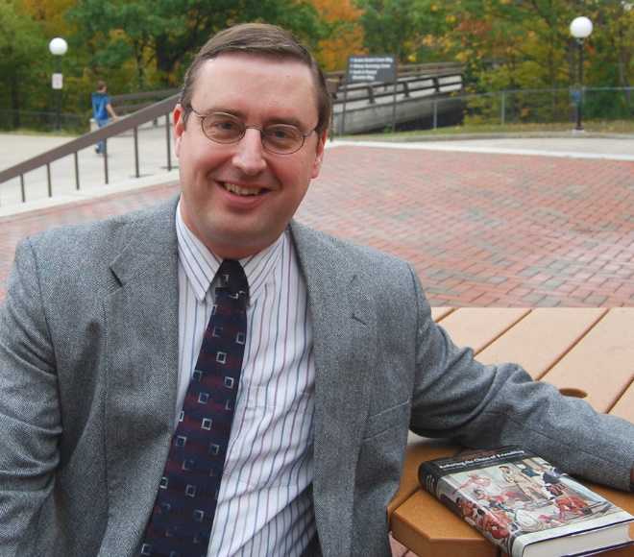
History
Tim Willig published a review of Robert M. Owens’ Red Dreams, White Nightmares: Pan-Indian Alliances in the Anglo-American Mind, 1763-1815 for The American Historical Review.

Slide 3
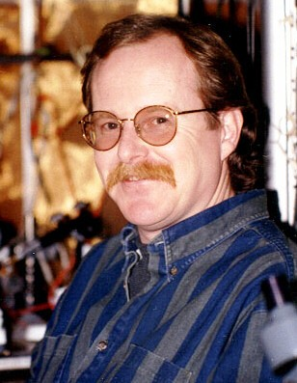
Biology
Tom Clark’s paper, “Systematic review and meta-analysis indicates that Cannabis use substantially reduces the premature death rate in the United States,” was accepted by the journal BMC Public Health pending revision.

Slide 4
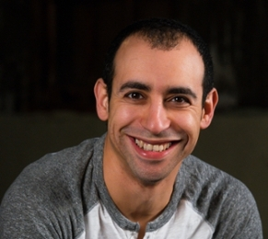
Chemistry
Shahir Rizk has been appointed as adjunct assistant professor of biochemistry and molecular biology at the IU School of Medicine.

Slide 5
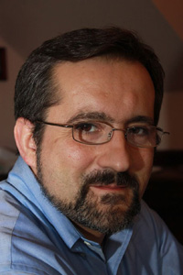
World Language Studies
Julio Hernando published an article “Los dichos o sentencias de los siete sabios de Grecia, de Hernán López de Yanguas: la tradición textual” in the journal Aliento.

Slide 6
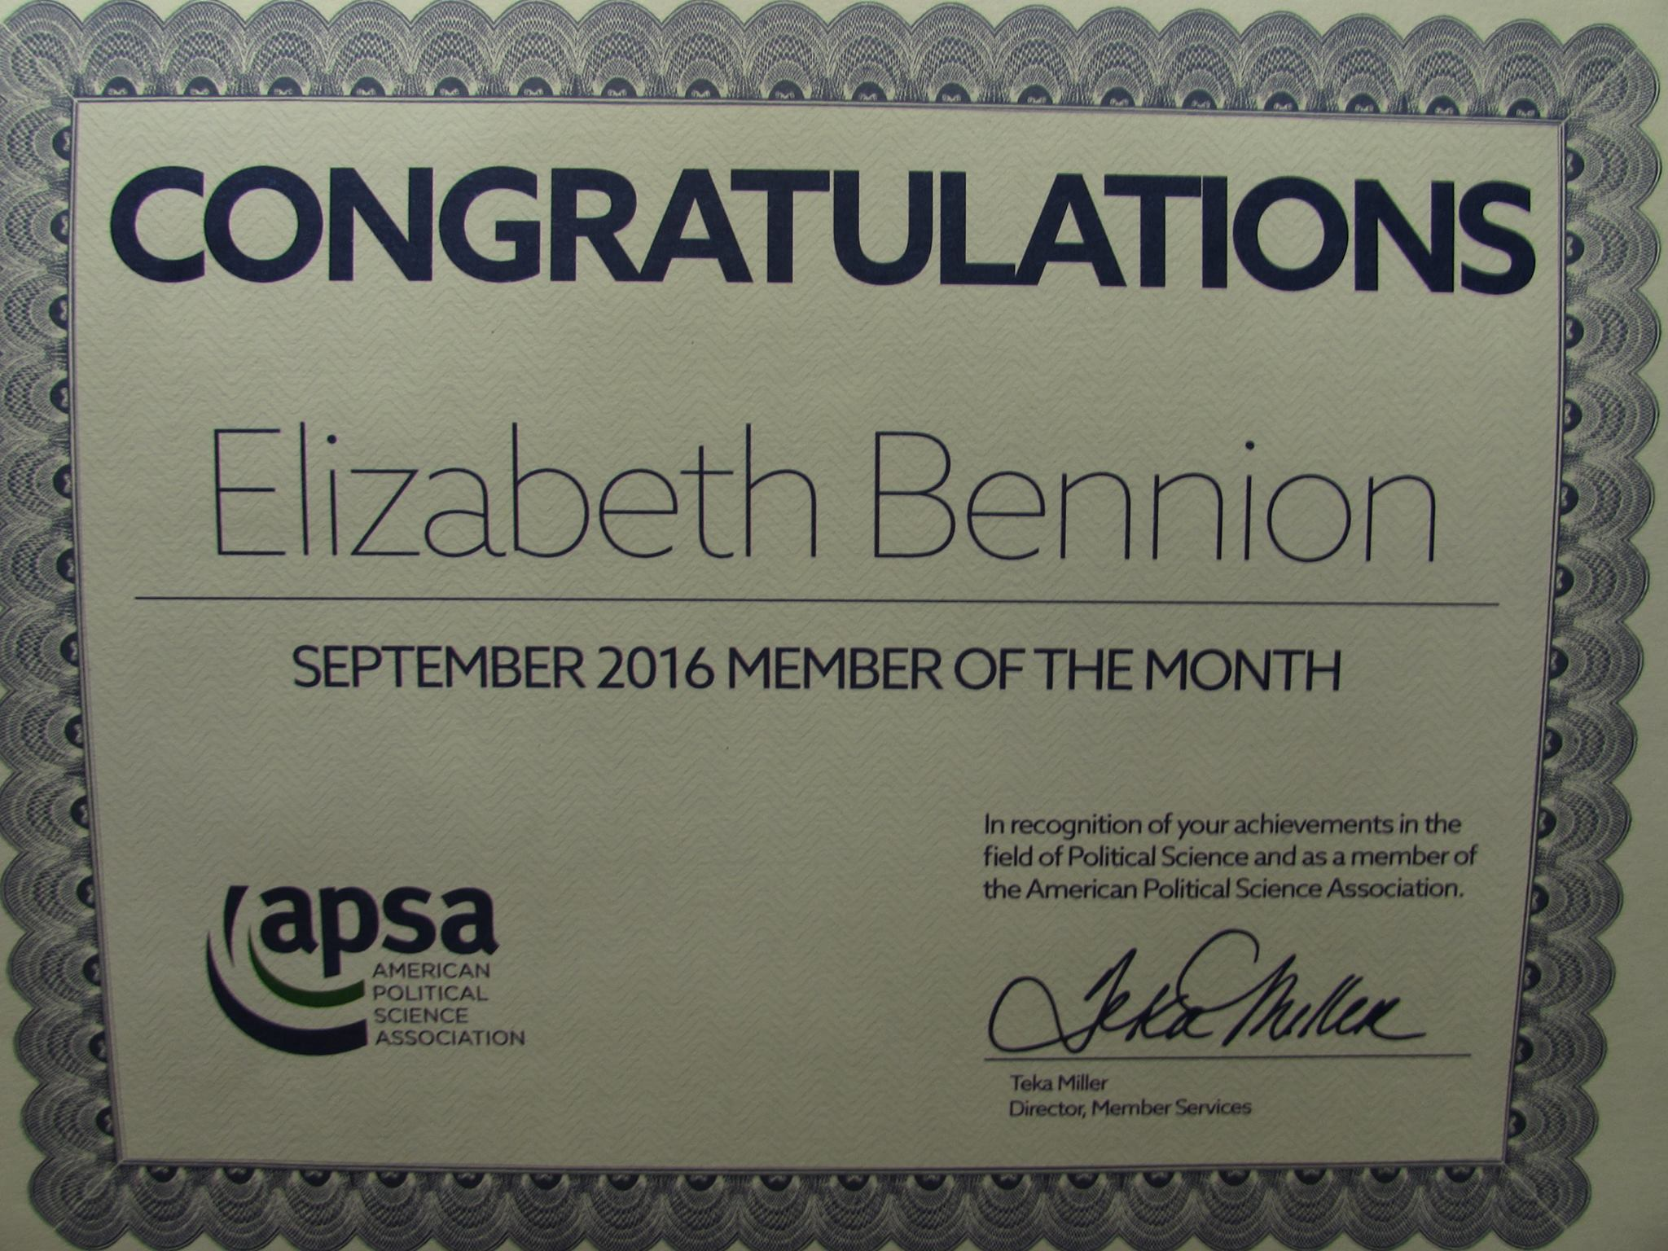
Political Science
Elizabeth Bennion was selected as the first ever Member of the Month by the American Political Science Association.

Slide 7

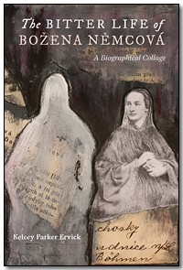
English
Nancy Botkin’s work is included in Not Like the Rest of Us: An Anthology of Contemporary Indiana Writers, edited by Barbara Shoup and Rachel Sahaidachny.
Kelcey Parker Ervick’s new biographical collage, The Bitter Life of Božena Němcová, is being released in early November.

Slide 8
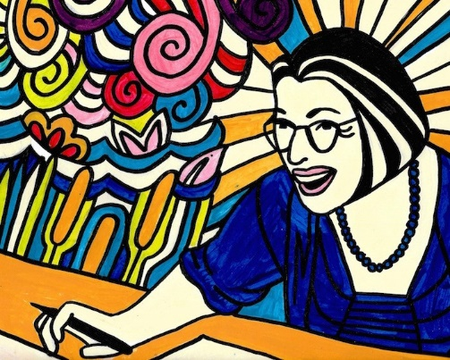


English Cont’d
McKenzie Tozan’s poem, “Shopping for T-Rex,” was nominated for Sundress Publications’ Best of the Net 2016 award by Whale Road Review.
Rob Russell’s new novel, New Plains, will be coming out soon from Dock Street Press.
Marcy Holland has completed the FACET peer reviewer training and is now available to do formative peer reviews.

Slide 9

Women’s and Gender Studies
April Lidinsky and Carolyn Schult presented “Games, Growth, and Gender: Strengthening Students' Academic Self-Efficacy" at the 23rd National Conference on Students in Transition in New Orleans.
Andrea Rusnock has two articles in and is the invited guest editor for the 2016 edition of Experiment: A Journal of Russian Art and Culture. This year's volume is titled A Stitch in Time: A Century of Russian Needlework and Fashion and the articles are "Sof’ia Davydova and the Study of Lace in Imperial Russia" and "Vladimir Stasov and Russian Folk Ornament: An Introduction." She also was the invited peer reviewer for an article for the journal Textile History​.

Slide 10
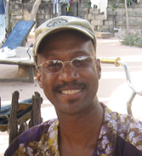
Sociology & Anthropology
Theo Randall presented a paper "Cultural Continuity and Change among the Lelna of Northwestern Nigeria" at the annual meeting of the Indiana Academy of Social Sciences at Purdue University Northwest.
Kathi Piekarski has been asked to bring the “Relax with a Dog” event to Southwestern Michigan College.

Slide 11
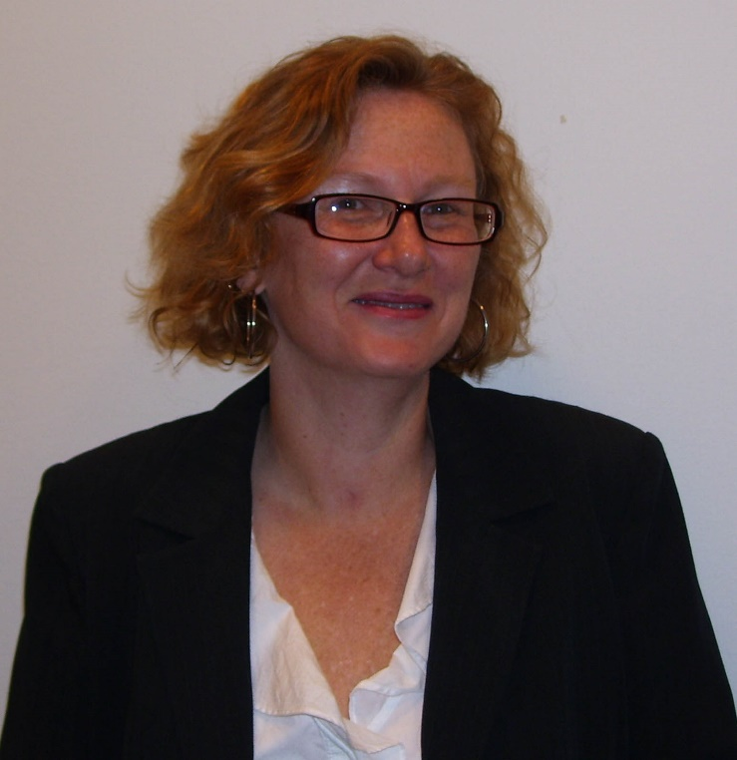
Psychology
Igor Juricevic contributed to two talks, Understanding Pictorial Metaphor: The Interaction of Context and Structure (with C. Crawford) and Two Metaphorical Pictures: LA-MOAD Theory Predicts Static Depictions but Not Motion Pictures (with C. Jackson), at the annual meeting of the Indiana Academy of the Social Sciences in Westville Indiana.
Catherine Borshuk presented a poster “The Famous vs. The Knowledgeable: The Influence of Celebrity and Expertise on Willingness to Believe and Follow ‘Quick Fix’ Advice” at the Indiana Academy of Social Sciences at Purdue North Central.

